Slide 1
SKYLINE INSTITUTE OF ENGINEERING & TECHNOLOGY GREATER NOIDA PROJECT ON PADDLE LESS TRICYCLE
PRESENTED TO:- MR. MAHIP SINGH PRESENTED BY:- MOHD MONISH
(MECHANICAL DEPARTMENT) ATIQUR RAHAMAN
MAYANK RAI
ADITYA VIKRAM
GOVIND SINGH
VINEET JAISWAL

Slide 2
Aim
A hand-powered tricycle provides great freedom for a disabled individual.
The tricycle frame consists primarily of square steel tubing, and the mechanical components are bicycle parts that are available at the local market.
The purpose of this project was to make improvements to the current design.

Slide 3
Objective
We planned to design and built a tricycle that :
Converts energy efficiently by transferring a minimum of 75% of the energy exerted by the rider to motion.
No physical injury over a period of time or muscle imbalance by working one arm harder than other.
Use local materials and craftsmanship so that it can built by nationals over a 3-week working period.

Slide 4
Introduction
The hand-powered tricycle was designed to meet their need for transportation.
It does not require the use of their legs because it has a bicycle crank that is operated by their arms and drives the front wheel.
The design is direct drive with hand pedals to power the front wheel.
Bicycle parts such as the rack and pinion, spur gears, flywheel and crank are available at the local market and make up the mechanical component of the tricycle.
The size and positioning of the seat are standard.
The steering shaft is connected to the hand crank so that the rider can do both motions at the same time with his arms.
The frame of the tricycle is built entirely of steel materials, primarily square tubing.

Slide 5
Design objective
Maintain stability (All three wheels stay on the ground) by turning within a radius of 2.3m while travelling at a velocity of 3m/s(6.7mph), which is a comfortable speed.
Prevent of the front wheel from wearing by using a proper caster angle. This will allow the wheel to continue going straight if it is suddenly turned to the side by a bump in the road rather than being pulled sharply to the side as this would be unsafe.
Maintain user accessibility by allowing a disabled person to get in and out of the tricycle unassisted within 1 minute.
Provide maneuverability by turning around within a 3m x 3m area.
Back compute to find the max torque on the crank using crank traction limits from 350 to 400nm.

Slide 6
Components
Cycle Frame
Seat(17x17)(Width x Height)
Back Seat(17 x 15)
Wheel(600mm dia)(24 inch) Without tyre.
Rack and pinion mechanism
Spur gear
Flywheel
Bearing(Shaft)

Slide 7
Calculations
We also looked at the geometrical relationships and how these factors affect the force the rider must put on the crank.
By doing a static analysis of the ,moment about the crank axle and the wheel axle, we get the following relationship :
Fr = force input by rider
f = friction force
r_{a} = radius of crank sprocket
r_{b} = radius of freewheel sprocket
r_{c} = crank arm length
r_{w} = radius of the front wheel
Fr=(f r_{a} r_{w)} / (r_{b} r_{c)}

Slide 8
Fr=f r_{a} r_{w} / r_{b} r_{c}
This shows us that in order to decrease the force by the rider, we must decrease the friction force, the radius of the crank sprocket, or the radius of the wheel, or we must increase the radius of the freewheel sprocket or the length of the crank arm.

Slide 9
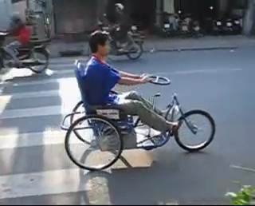
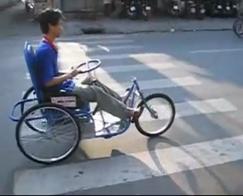
Moving Motion (Forward and backward)

Slide 10
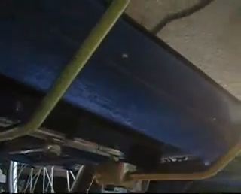
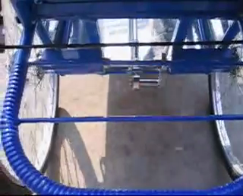
Turning mechanism(Left and right)
Rack-Pinion Mechanism

Slide 11
THANKS

